Slide 1
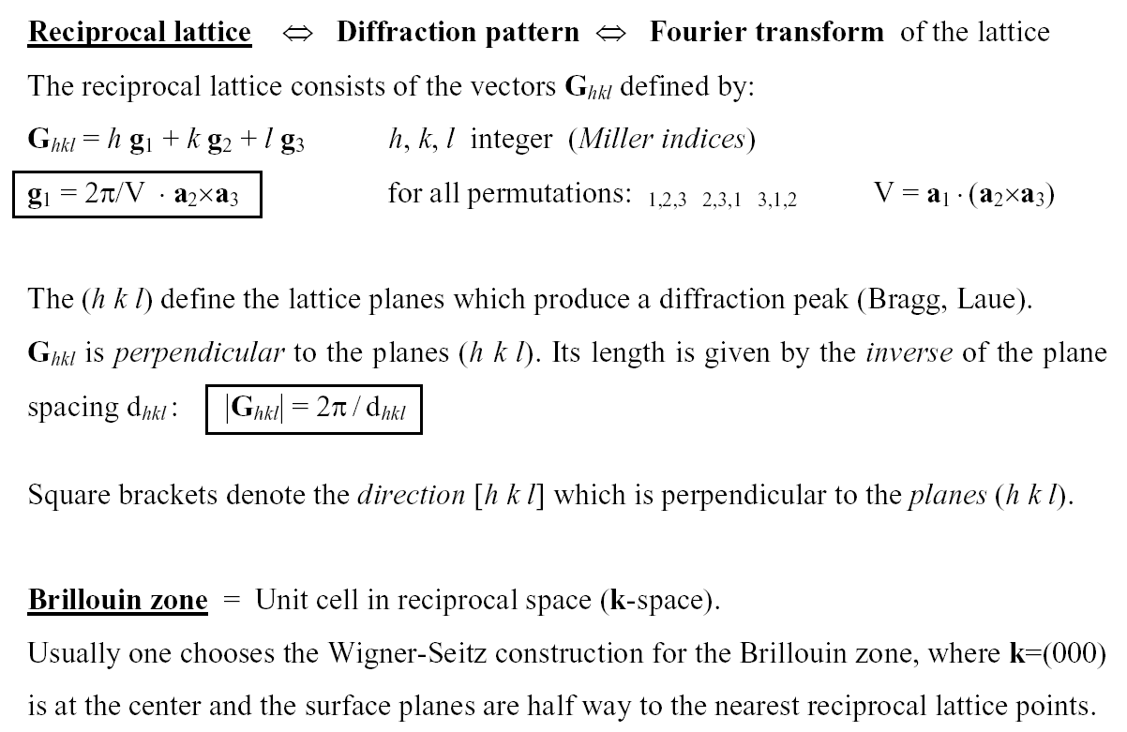
Reciprocal Lattice
the
the

Slide 2
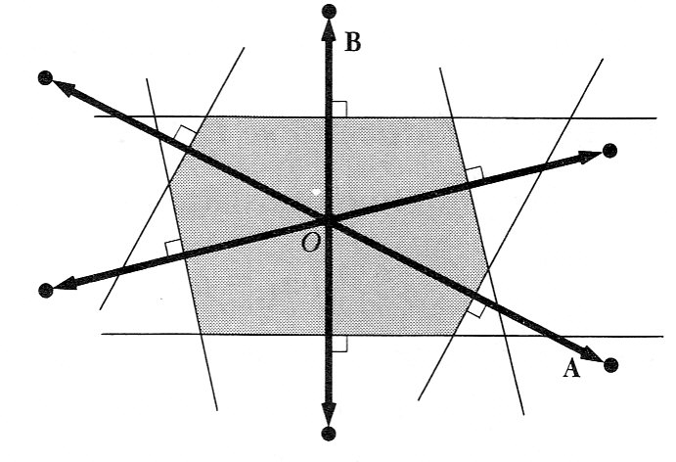
Brillouin zone
The Brillouin zone is the unit cell in reciprocal space (= k-space = momentum space). It is constructed by the Wigner-Seitz method , where k = (000) is the zone center, and the zone boundaries are half way to the nearest reciprocal lattice points: k_{ZB} = ½ G_{hkl}
G_{hkl}
k_{ZB}
k_{y}
k_{x}

Slide 3
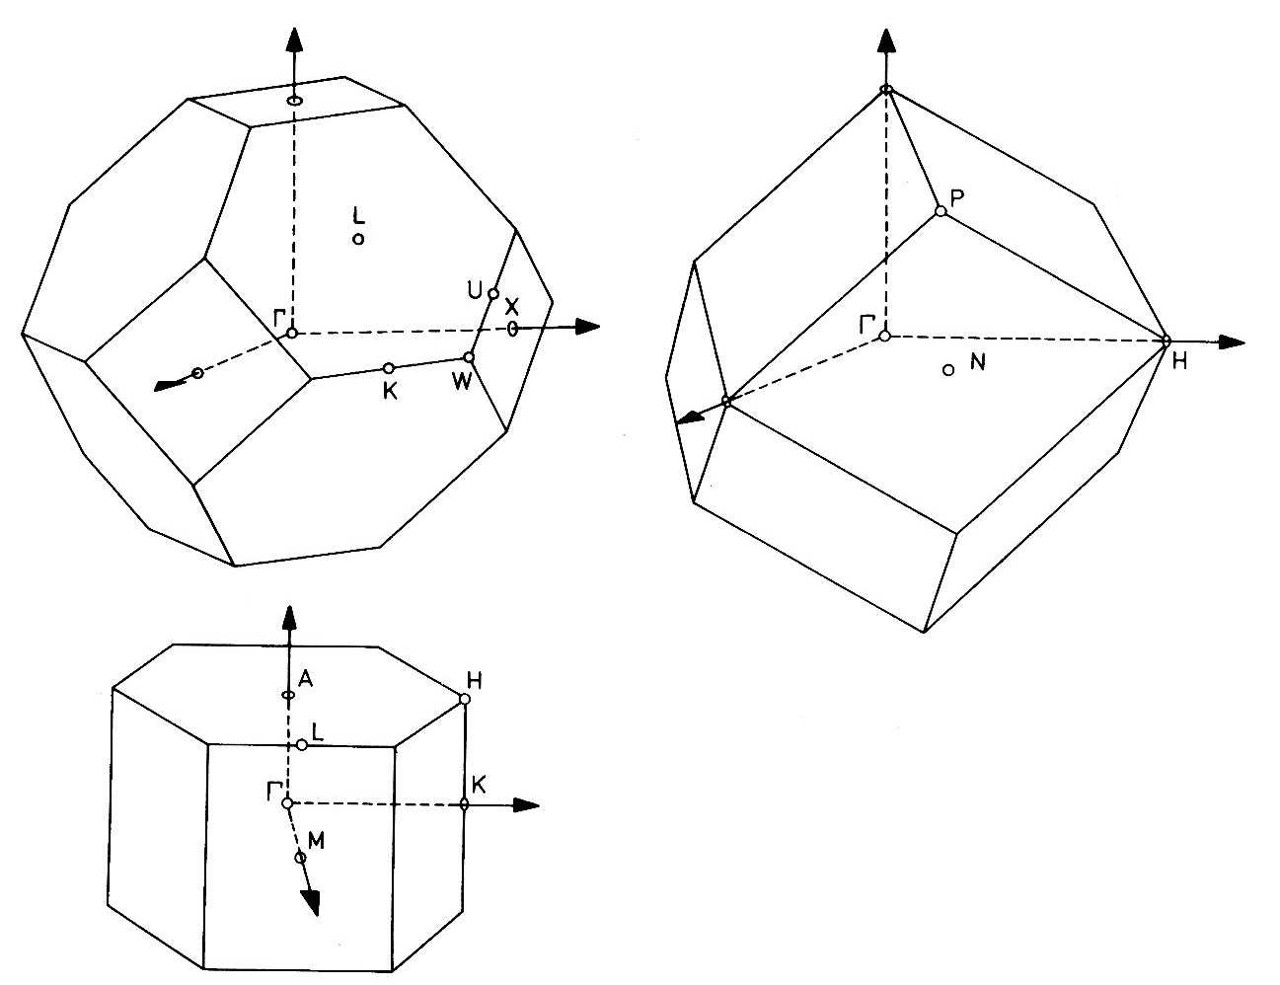
Brillouin zones for common lattices
fcc
bcc
The reciprocal lattice of fcc is bcc and vice versa.
hcp

Slide 4
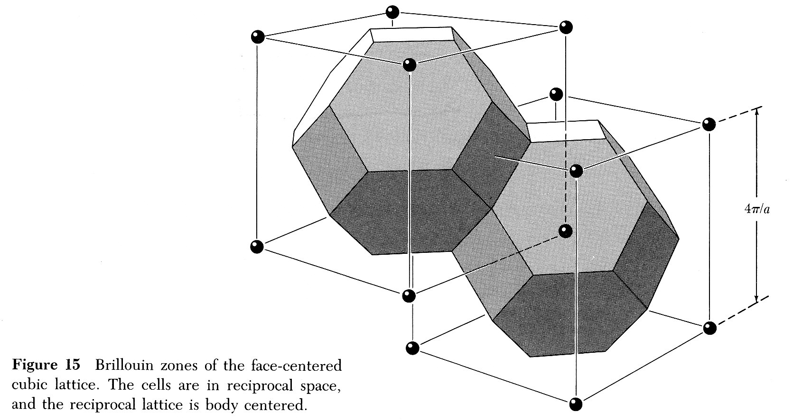
Outer Brillouin zones
Reciprocal space can be completely filled with Brillouin zones that are shifted from the central Brillouin zone by reciprocal lattice vectors G_{hkl} .
(-1 1 1)
(-1-1 1)
(1 1 1)
The reciprocal fcc lattice is bcc . It consists of G_{hkl} with hkl either all even or all odd (units of 2π/a). These belong to the two cubic sub-lattices which form the bcc reciprocal lattice (center points and corner points).
The edges of the cubes in k-space are 2 · 2π/a long, because the spacing of the fcc planes in real space is ½ · a ( |G| = 2π/d_{plane}).
(0 2 0)
(2 2 0)
(0 0 0)
(2 0 0)
(1 1-1)
(-1-1-1)
(1-1-1)
(2 2-2)
(0 0-2)
(2 0-2)

Slide 5
General theory of diffraction
X-rays scatter off the charge density ρ(r) , while neutrons probe the spin density. Diffraction of a coherent plane wave creates a Fourier transform of ρ(r) from real to reciprocal space :
Ã(k) = ∫ ρ(r) e^{−i q r} d³r Ã = |Ã| ⋅ e ^{i Φ} I = |Ã|² =
q = k−k₀ = k-transfer
measured
intensity
k₀
k
ρ(r) I(k)
Real space Reciprocal space
Fourier transform from r to k : Ã(k) = ∫ A(r) e^{−i k r} d³r
Inverse transform from k to r : A(k) = (2π)⁻³ ∫ Ã(k) e^{+i k r} d³k

Slide 6
Structure determination for periodic solids
The diffraction pattern is determined by three factors:
The Bragg condition (= energy and momentum conservation) determines the position of the diffraction spots in k-space. It represents the crystal lattice .
The structure factor describes the intensity modulation of the diffraction spots by the atoms inside the unit cell (the basis) . This is the quantity measured for protein crystallography.
The atomic scattering factor describes diffraction by the charge distribution inside an individual atom . It is a known quantity .
Large objects in real space correspond to small objects in k-space :
The largest object in real space (the infinite lattice) becomes the smallest object in k-space (a lattice point = δ-function).
The unit cell represents a medium-sized object in real space.
The smallest object in real space (an atom) modulates the intensity everywhere in k-space by the atomic scattering factor.

Slide 7
Structure factor
The structure factor S_{hkl} is given by:
S_{hkl} = Σ_{α} f_{α} exp[-i G_{hkl} r_{α}]
= Σ_{α} f_{α} exp[-i 2π (h ·u_{α}+ k · v_{α}+ l · w_{α})]
where r_{α} is the position of atom α inside the unit cell and f_{α} its atomic scattering factor. r_{α} can be expressed by integer multiples u_{α},v_{α},w_{α} of the real space lattice vectors, just like G is expressed by the Miller indices h,k,l in k-space.
If one chooses a unit cell larger than the primitive (= smallest) cell, the structure factor leads to the extinction of certain Bragg spots , because of destructive interference between equivalent atoms in the unit cell. For example, the (100) spot vanishes for the fcc lattice due to the extra face-centered atom at (u,v,w) = (½, 0, ½). For the diamond lattice in Si both the (100) and (200) spots vanish due to the extra atom at (¼, ¼, ¼).

Slide 8
Atomic scattering factor
The atomic scattering factor f_{α} of X-rays is given by:
f_{α} = ∫ ρ_{α}(r) · exp[-i G_{hkl} r] d³r
where ρ_{α} is the charge density of a single atom inside the unit cell . The integral over the charge density of an atom is proportional to the number of electrons, i.e. to the atomic number Z . The square of the structure factor determines the diffraction intensity . As a result, the diffraction intensity of X-rays increases strongly for heavy atoms (high Z) . Light atoms (H,C,…) are hard to detect in the presence of heavy metal atoms.
Neutrons scatter very efficiently from light atoms in soft matter, since the momentum transfer is largest for equal masses, such as a H atom and a neutron.

Slide 9
Neutron diffraction: Small Angle Neutron Scattering (SANS)
Works for light elements (hydrogen, deuterium, soft matter) and for magnetic materials (magnetic moment of the neutron).
a
I
q_{½} ∝ 1/R_{g}
R_{g}
q
Model of a polymer:
R_{g} = Radius of gyration (overall size) a ≈ Persistence length (straight sections)
Diffracted neutron intensity I plotted versus the k-transfer q

Slide 10
Experimental methods for structure analysis
Energy and momentum conservation impose four constraints on the diffraction in three dimensions. They cannot all be fulfilled by adjus-ting the three k components of the diffracted wave (with the incident wave fixed). Something else has to give . Either the energy E₀ or the wave vector k₀ of the incident wave needs to be variable. This can be accomplished in several ways:
Use incident x-rays with a continuous energy spectrum (Laue).
Rotate the crystal (popular with protein crystallography).
Use polycrystalline samples (powder diffraction, Debye-Scherrer).

Slide 11
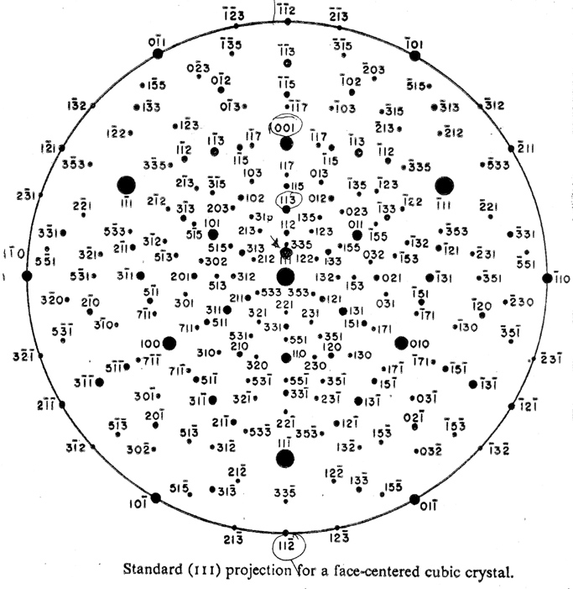
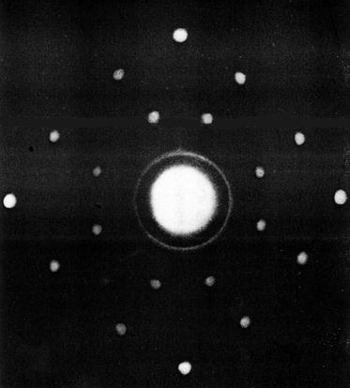
Laue diffraction pattern
Laue diffraction pattern of NaCl taken with neutrons.
See a projection of k-space.

Slide 12
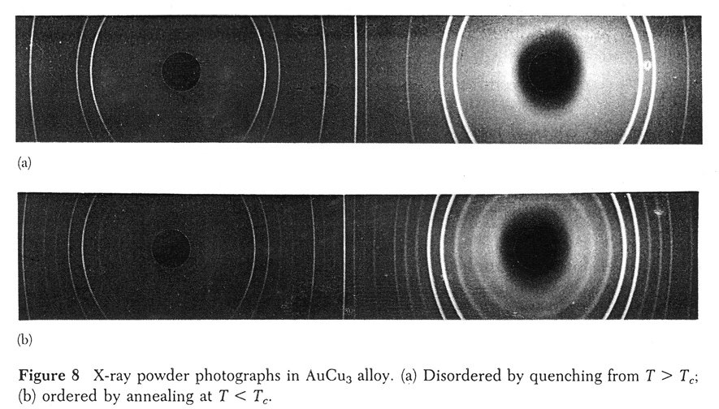
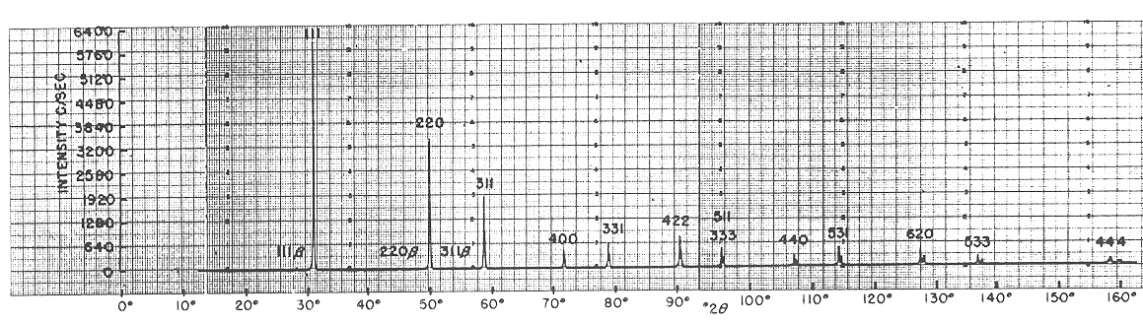
Powder diffraction pattern
Observe rings around the incoming and outgoing beam.
(Cylindrical film unfolded.)
Extra diffraction rings visible for the ordered Cu₃Au alloy.
Horizontal scan across the rings for Si powder. The (100), (200) reflections are forbidden in the diamond structure, since their structure factor vanishes.

Slide 13
The phase problem
Mathematically, an object in real space can be reconstructed from the ampli-tude of the diffracted wave in k-space by an inverse Fourier transform from k to r . But the amplitude is a complex number of the form A = |A| · e^{i Φ}, which contains the phase Φ. Only the intensity I = |A|² is measured, not the phase.
Crystallographers have developed tricks to retrieve the phase. In protein crys-tallography, sulfur in selected amino acids can be replaced by selenium. It is chemically similar but heavier. Selenium diffracts X-rays strongly, particularly when the X-ray energy is tuned to an inner shell excitation (anomalous scat-tering). The difference between the diffraction patterns on- and off-resonance provides the phase information.
Simple crystal structures can be solved by calculating the diffraction pattern for trial structures containing adjustable parameters. Those are obtained by a least square fit to the diffraction intensities.

Slide 14
Reconstruction of a single nano-object (ptychography)
With the advent of laser-like X-ray sources, there has been great interest in Fourier-transforming the diffraction pattern of a single object, for example a virus (next slide). A theorem allows the reconstruction of the phase, as long as the object is located in a known, finite region of space (inside an aperture) . The strategy for reconstructing the object uses an iterative method:
1) Start with arbitrary phase in k-space and perform an inverse Fourier trans-form from k to r. The phase error will produce a finite amplitude outside the aperture, where it should be zero.
2) Set the amplitude outside the aperture to zero, but keep the phase inside.
3) Perform a Fourier transform from r to k . The phase error will again give the wrong amplitude, this time in k-space.
4) Reset the amplitude in k-space to the observed diffraction amplitude, but keep the phase. Go back to 1) .
This loop needs to be iterated many times, but it converges eventually to the correct amplitude and phase in both r and k. Such a method allows lens-less imaging with atomic resolution, limited only by the wavelength of the X-rays.

Slide 15
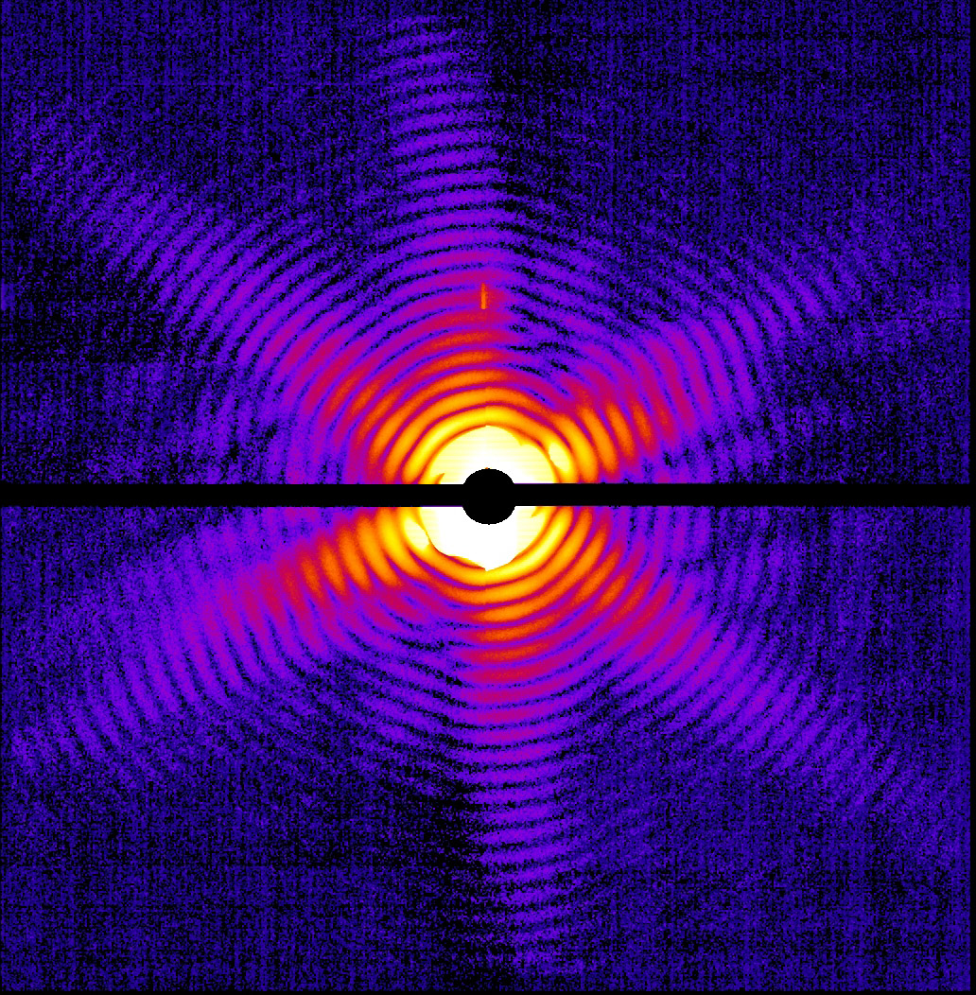
Diffraction from a single object
X-ray diffraction pattern of a single Mimivirus particle imaged at the LCLS at Stanford, which produces laser-like X-rays.
The X-ray pulse stripped most of the electrons from the atoms, leading to a Coulomb explosion. But it was so short (< 50 femtoseconds) that the atoms did not have time to move until after this image was obtained (“diffract and destroy”).
Combining thousands of such images with various orientations of the virus (tomography) provides a three-dimensional image.

